Slide 1
Research Proposal

Slide 2


Introduction

Slide 3
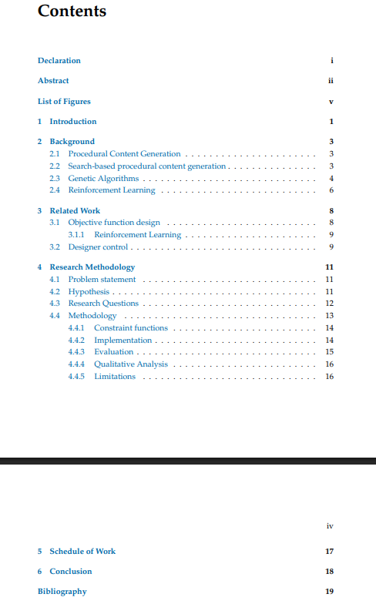
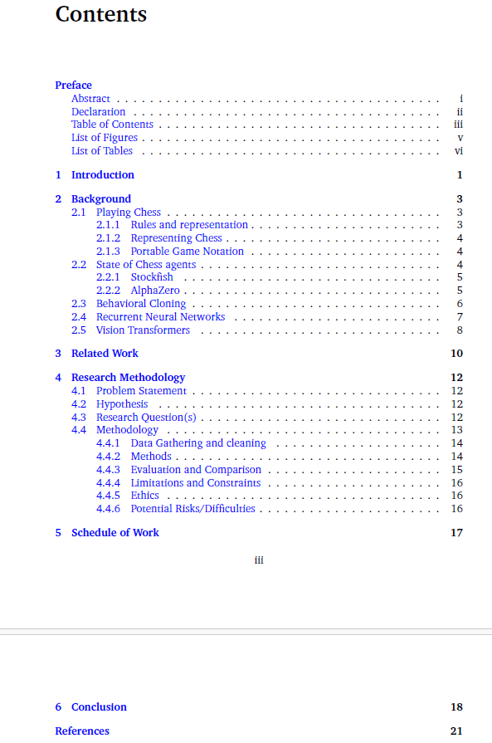
Structure

Slide 4
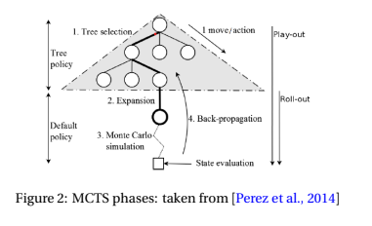
Presentation
Figures need to be clear / large / not pixelated

Slide 5
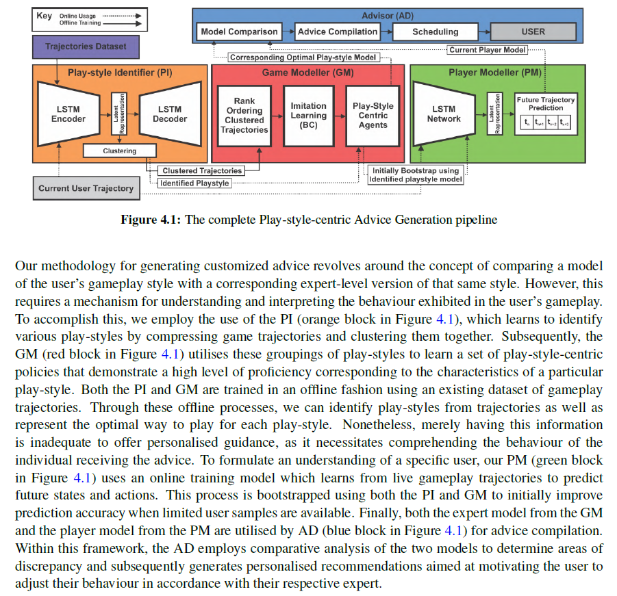
Presentation
Figures need to referenced from the text
Reference part of the figure if needed

Slide 6
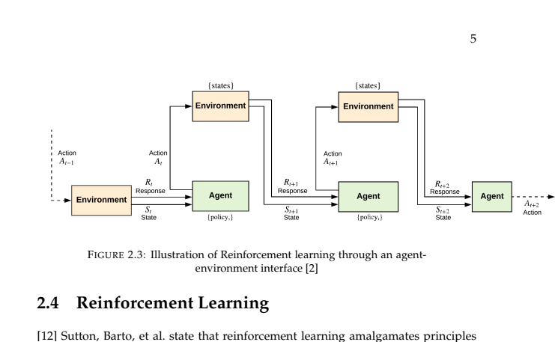
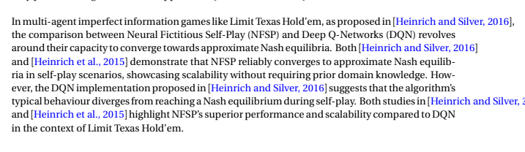
Presentation
Tables/Figures/Algorithms/Text need to obey margins

Slide 7
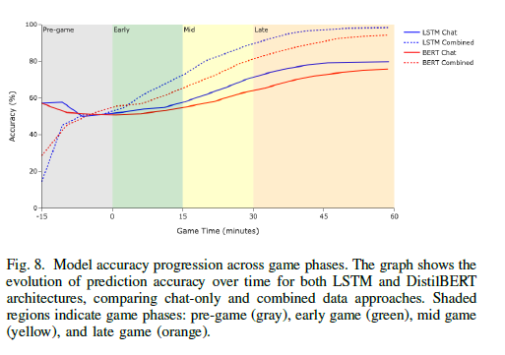
Presentation
No text even inside a Figure can be smaller than a default caption

Slide 8



Presentation
Use correct apostrophe
`` ‘‘

Slide 9
Citations
\citep
\citet
\citep{A,B}
Cite your Figures as well, unless you made it

Slide 10
Citations
Be more trigger happy when it comes to citations
Cite the seminal works when introducing concepts

Slide 11
Writing Style
Present Tense
The authors argue that
The authors present
The authors demonstrate
The authors show
Temporal Wording
More recently,
Modern techniques,

Slide 12
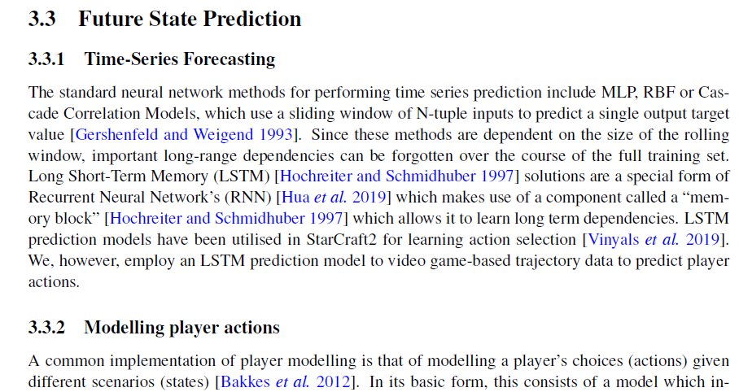
Writing Style
Connective Phrasing

Slide 13
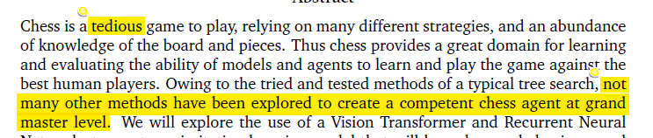
Writing Style
Precise statement of fact

Slide 14
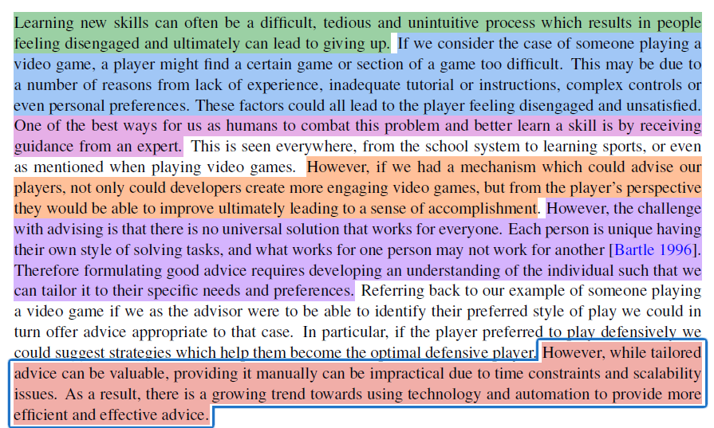
Introduction Section
General Problem
Easy to understand example
Conceptual Solution leading to specific Problem
Why it is interesting
Why it is difficult
Specific Solution

Slide 15
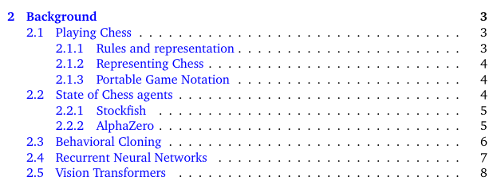
Background Section
The background section should teach me the specifics of how a thing works

Slide 16
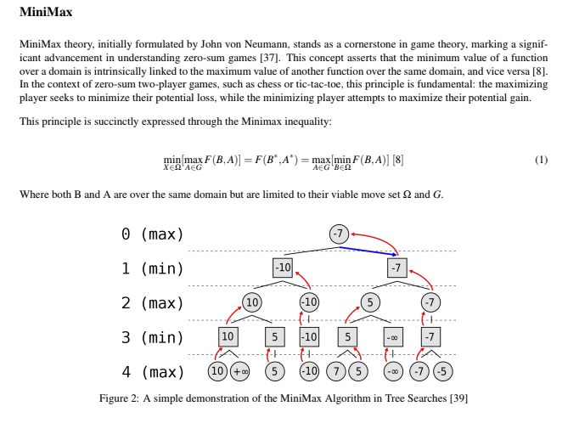
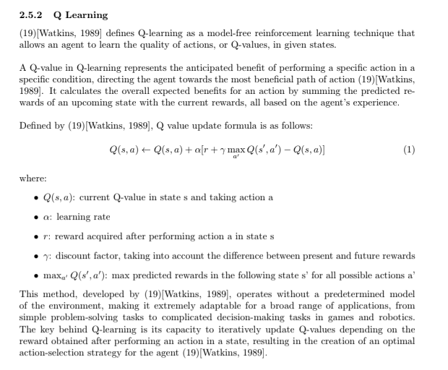
Background Section
Mathematically precise
How do models learn/update
What data structures are needed

Slide 17
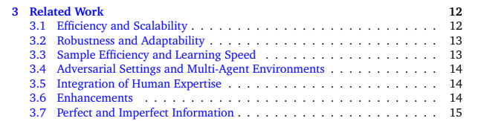
Related Work Section
Here you need to identify what are the important themes that make up the relevant work

Slide 18
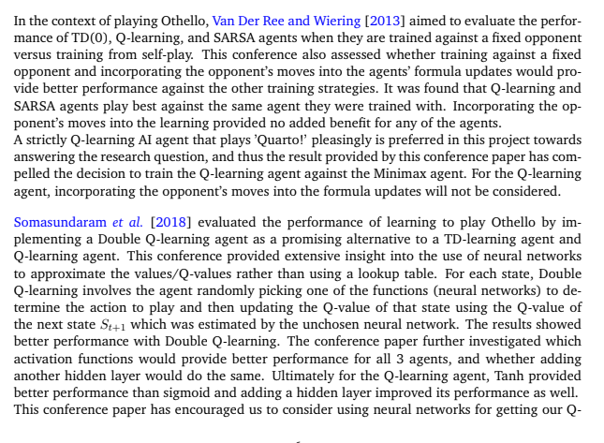
Related Work Section
Not a summary

Slide 19
Related Work Section
Needs to flow like a story with natural progression
so one storyline could be as follows; chess is a hard game -> initially Y researchers used X and Z techniques to create a chess bot, however they were limited because of P -> along came R who used another approach to overcome this -> we also use this by adapting it ... -> another problem in chess is L -> Q researchers in field J have applied T in a similar domain -> we leverage this by .

Slide 20
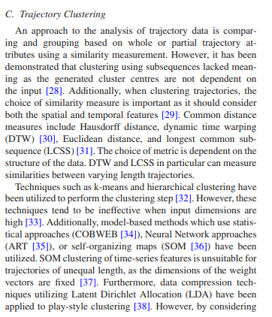
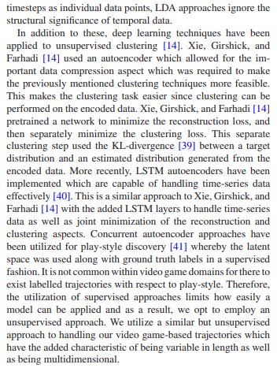
Related Work Section

Slide 21
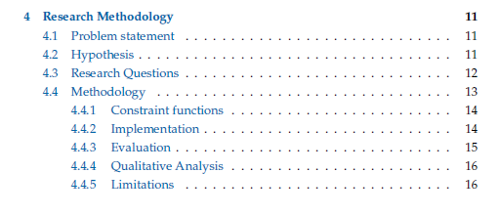
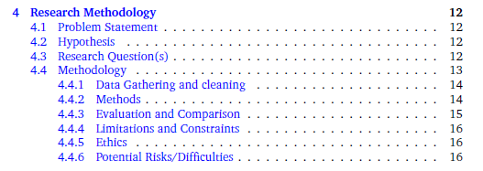
Research Methodology

Slide 22
Research Methodology
This is where you finally tell me explicitly what you are going to do
We will not hold you to this, things can change

Slide 23
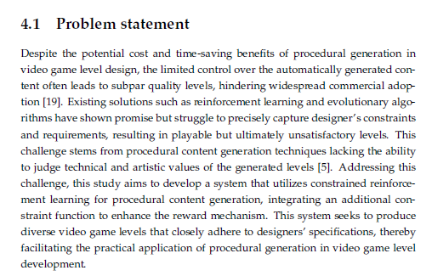
Problem Statement / Objective / Aim
This is the same idea as the AIM section in the AB, but it is your AIM for this work.

Slide 24
Research Questions
Your research question or hypothesis should be posed as something specific and answerable.
You should be able to imagine what result someone could present to you that will answer the question.
“It is possible to...” does not make for a useful hypothesis, as it is not providing useful information to future researchers on the topic.
“Method X is better than Method Y” should be quantified: in what way do you want it to be better?

Slide 25
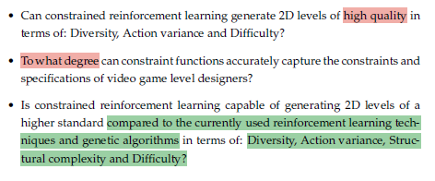
Research Questions

Slide 26
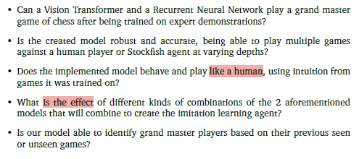
Research Questions

Slide 27
Research Questions
The experiment here is clear.
  Set up Quarto environment
  Implement Q learning and Minimax
  Play them against each other
  Measure performance

Slide 28
Methodology
When presenting your proposed methodology, give some idea of how you will proceed algorithmically:
which algorithms will you use, how will you set them up, what domains will you use, etc.
Even if you are not completely certain of which way you should proceed, you should at least put down your current thoughts.

Slide 29
Data Collection
Tell us of the dataset, simulation, environment you are going to be using, and more importantly how you are going to be interfacing or collecting it.
APIs, Surveys, Public Repos ect.
Is there a particular preprocessing that you are going need to do.

Slide 30
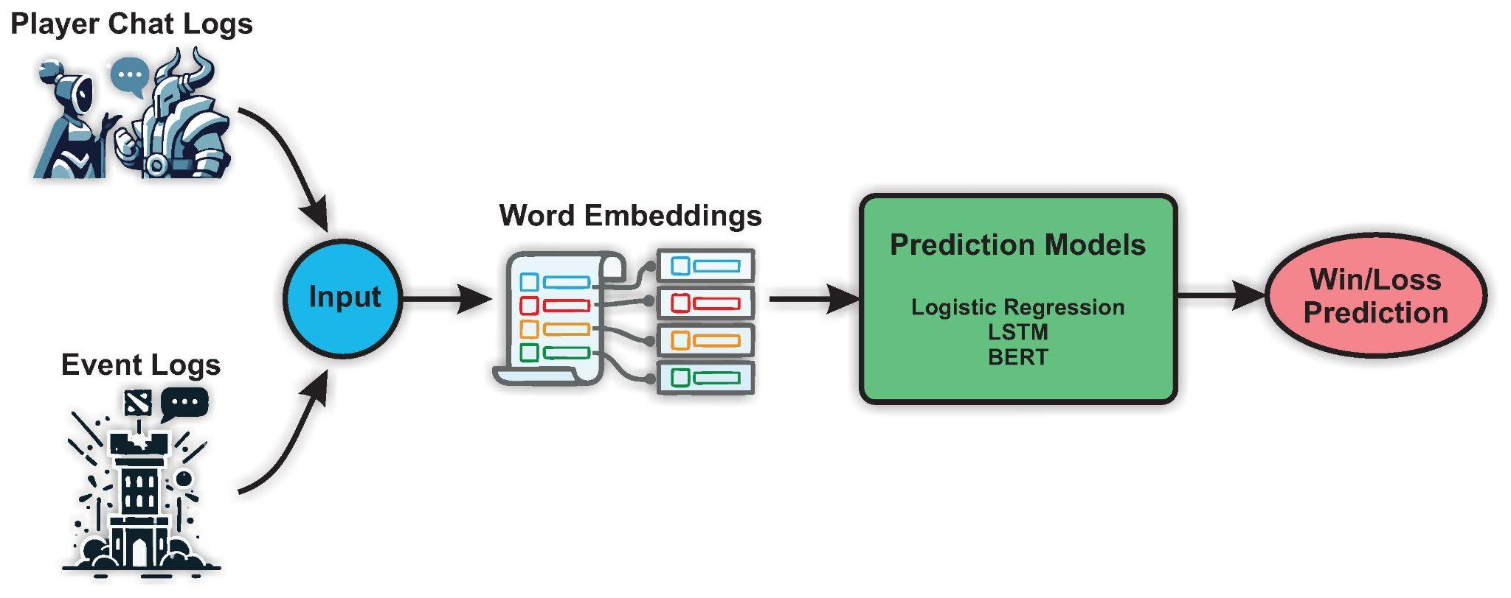
Methods
Describe your pipeline, the process of going from data to some model or system capable of being analysed to answer your research question.

Slide 31
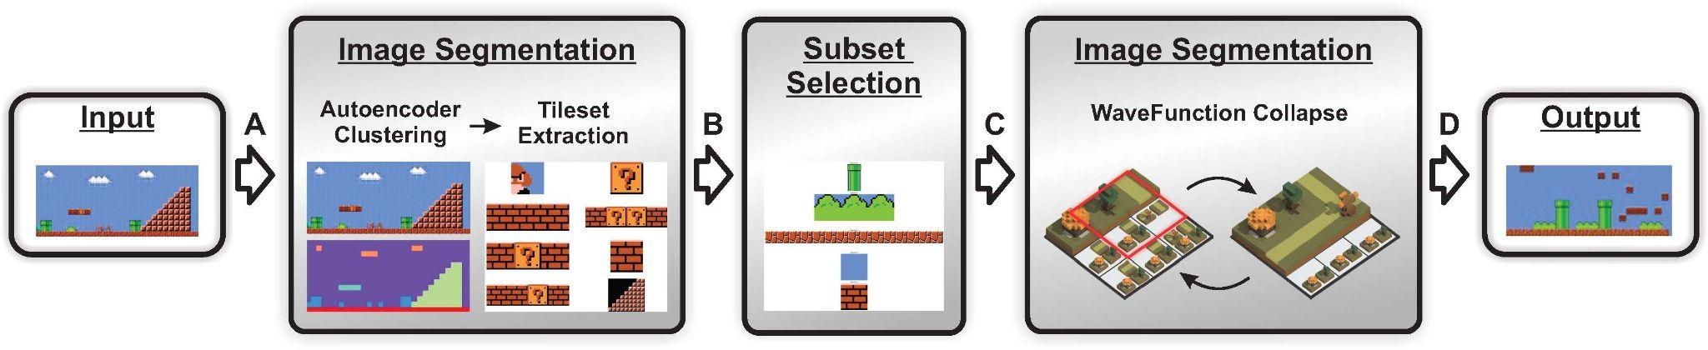
Methods
Utilise a figure and then describe the steps in that figure

Slide 32
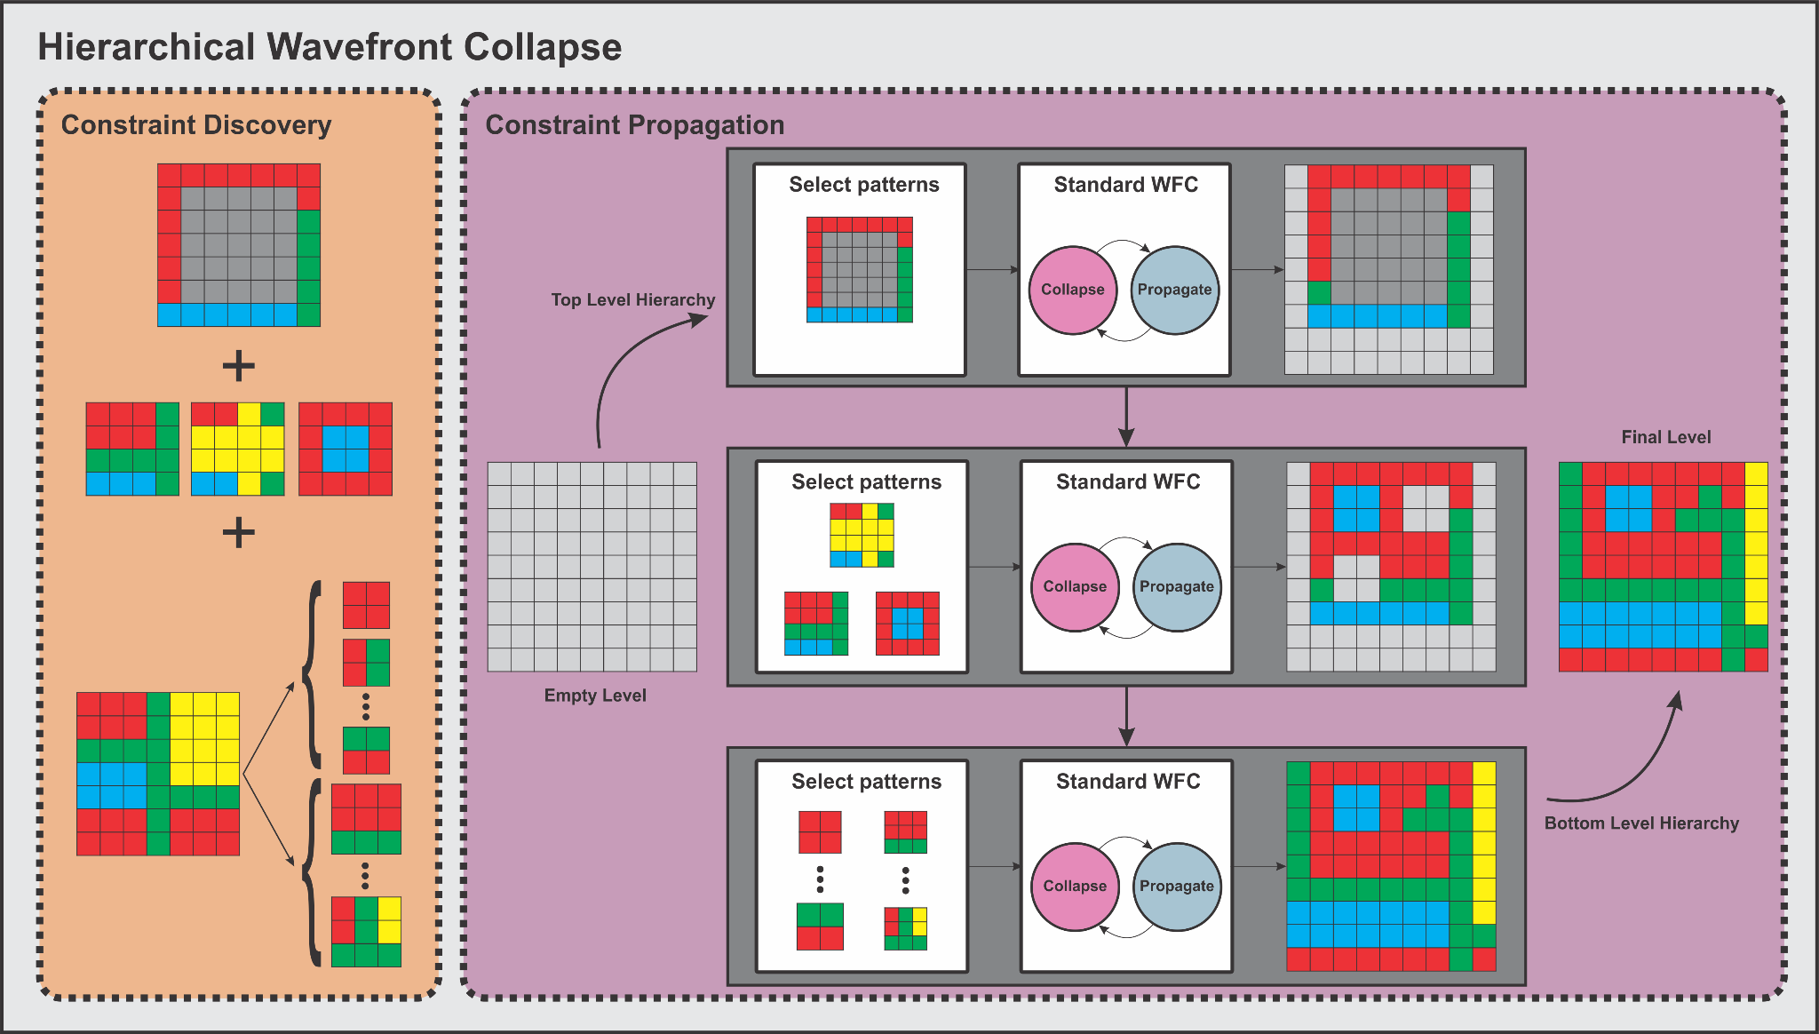
Methods
Utilise a figure and then describe the steps in that figure

Slide 33
Metrics
Describe in detail the metrics utilised to answer the questions.
  How are they calculated
  What is the intuition behind them
  Why are they appropriate
  How will they be implemented
Essentially what is your evaluation process

Slide 34
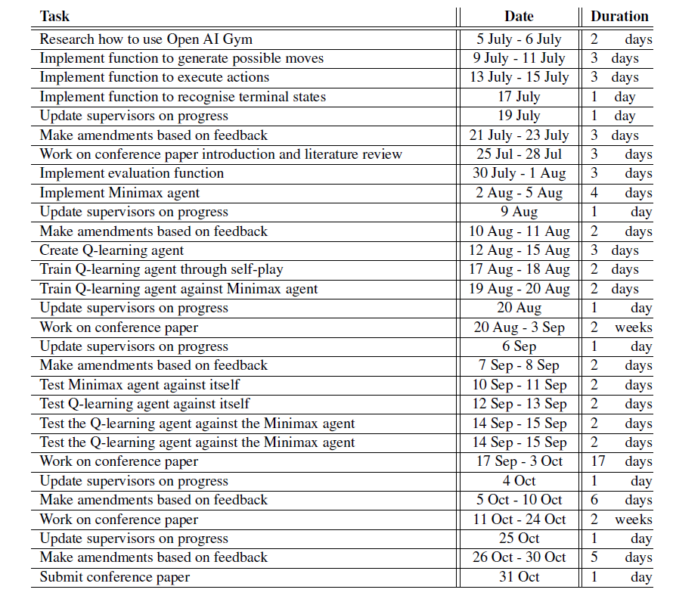
Work Schedule
Rough outline of your research plan
Too Detailed

Slide 35
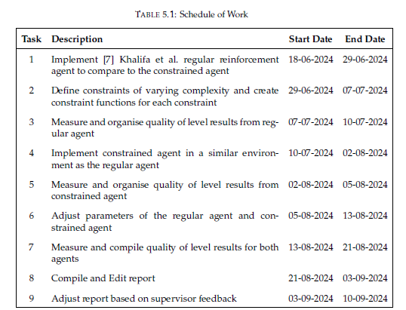
Work Schedule
Rough outline of your research plan

